Slide 1

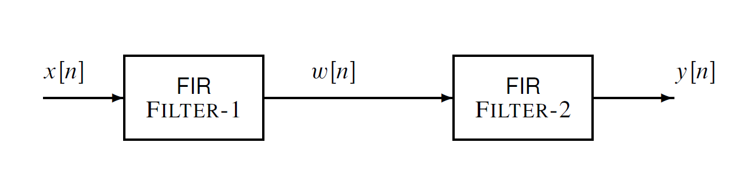
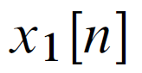
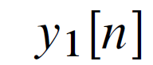

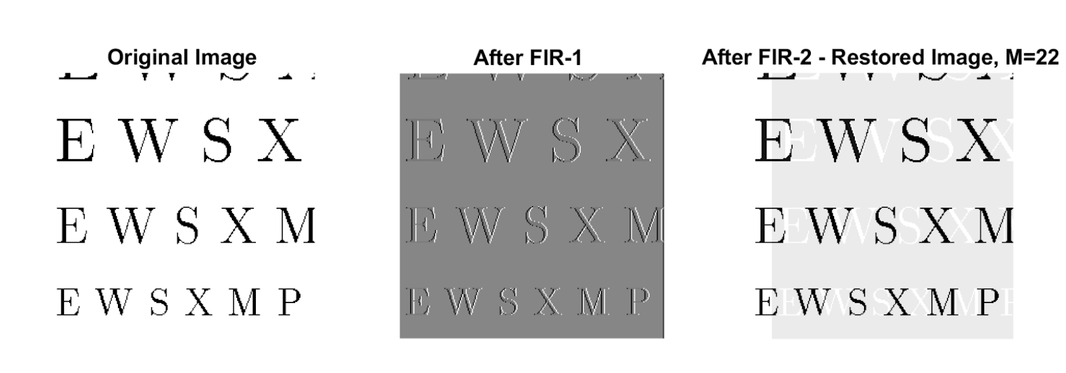
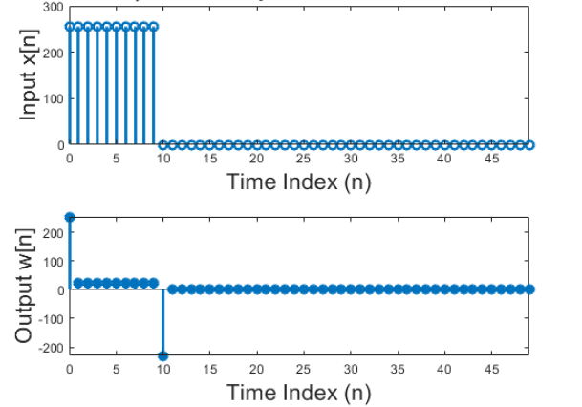
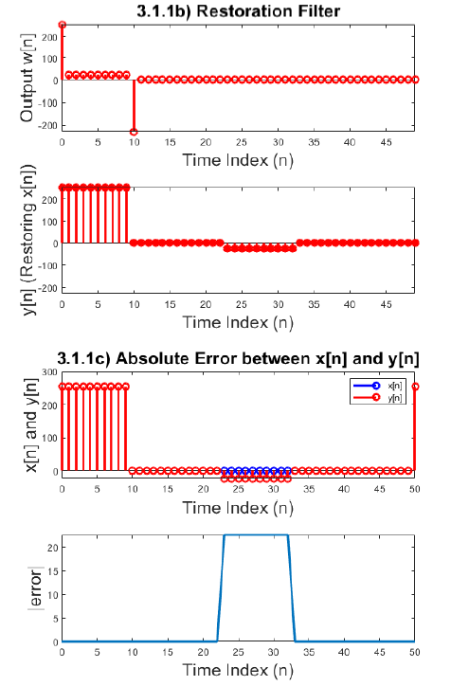
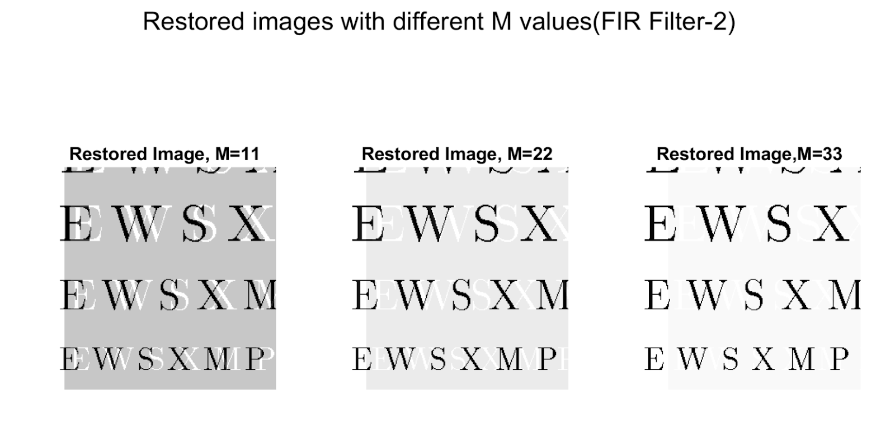
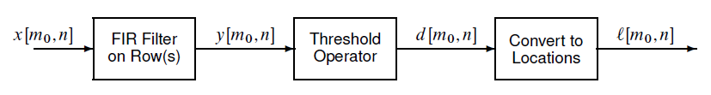
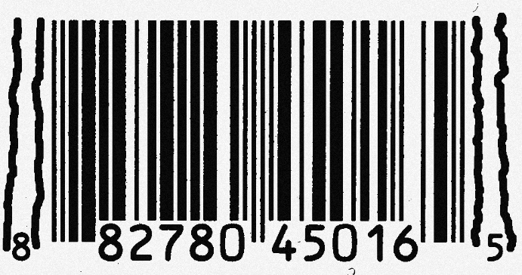
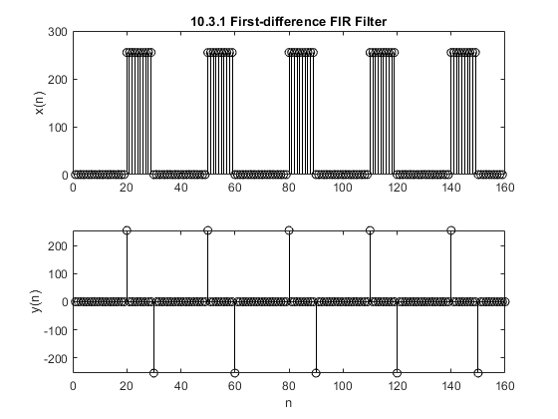
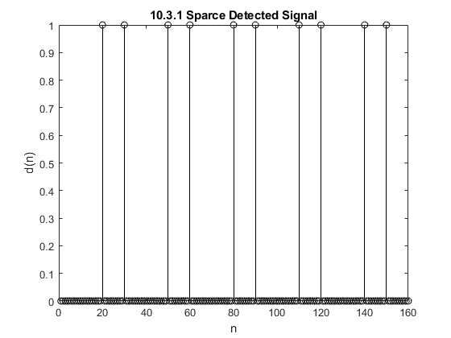
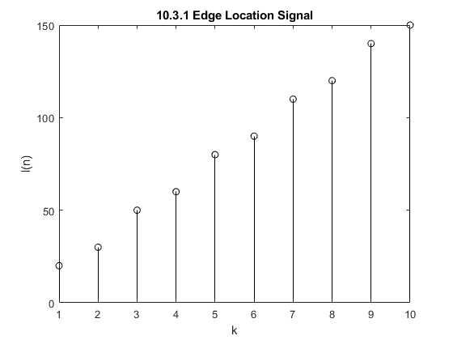
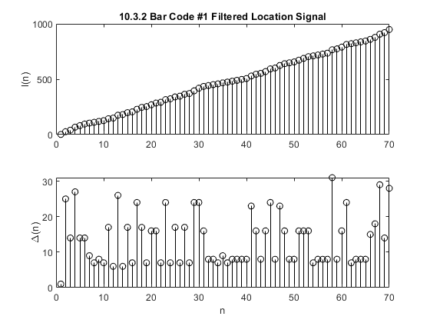
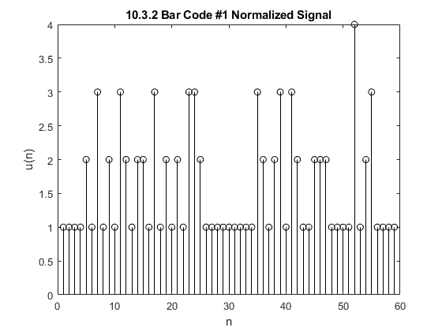




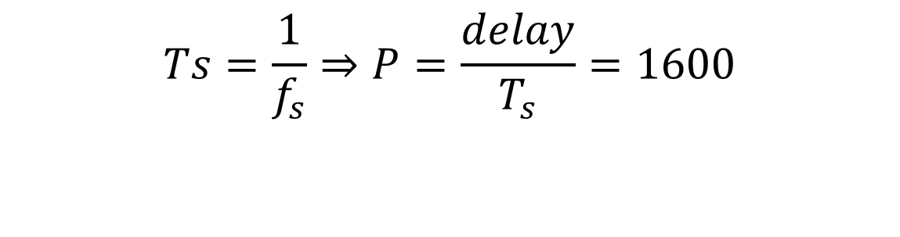
FIR Filters
Aaron Blanchard¹, Antonio Santos Aguilera¹, Caina Fernandes¹, Jason Porter¹
College of
Engineering
¹Department of Electrical and Computer Engineering, University of Utah
Instructor: Neda Nategh/ ECE 6530-090 Spring 2022 (Digital Signal Processing)
Introduction
Audio Effect
FIR filters are frequency-selective filters utilized in a variety of digital signal processing applications in which linear-phase integrity is important. Because FIR filters are computationally expensive compared to IIR filters, designing efficient filtering algorithms can be critical in applications with limited memory storage or a low tolerance for latency. However, FIR filters are inherently stable systems and do not introduce distortion into filtered signals. Therefore, FIR filters are often used in audio and image processing. This project investigates FIR filters commonly used in audio effect manipulation, signal restoration, and image edge detection.
Process
Application
Example:
You have an audio signal sampled at $f_{s}$=8000 Hz and would like to add a delayed version to simulate an echo. The time delay of echo should be 0.2 seconds, and strength of the echo should be 90% of the original.
Implement this filter.
Original Audio
Audio with Echo
Given, $f_{s}$=8000 Hz
delay =0.2 s
r =0.9 (90% of the original)
Click here to listen to Original Audio:
An Echo Filter:
$$y_{1}\left[n\right]=x_{1}\left[n\right]−r x_{1}\left[n−P\right]$$
$$Ts=\frac{1}{f_{s}}⇒P=\frac{delay}{T_{s}}=1600$$
Click here to listen to Audio with Echo:
Methods
Image Restoration
The following FIR filtering techniques were implemented in this research:
Echo:
A linear-phase shift that generates a signal delay with a relative magnitude to the original signal. This phenomenon produces echoes and reverberations in audio signals, as well as “ghosts” in images.
Cascading Systems:
The output of the first system is the input to the second system, and the overall output of the cascade system is taken to be the output of the second system.
$$\begin{aligned}w\left[n\right]=x\left[n\right]−q\left[n−1\right]\#\left(FIR Filter 1\right)\end{aligned}$$
$$\begin{aligned}y\left[n\right]=\sum_{l=0}^{M}{r^{l}w\left[n−l\right]}\#\left(FIR Filter 2\right)\end{aligned}$$
FIR Filter 1: utilized to create echoes on signals and data sets (audio, and image data).
FIR Filter 2: utilized to (approximately) undo the effect of FIR-Filter 1 . This type of application is called Deconvolution.
Deconvolution:
A signal processing technique used to rectify an undesired convolution. This is useful in image restoration.
First-Difference Filter: $y\left(n\right)=x\left(n\right)−x(n−1)$
A filter designed for detecting significant fluctuations in a signal. This concept is known as edge detection and can be used in many image processing applications including bar code scanning.
Process
Application
1
2
3
Filter coefficients
FIR Filter 1: q=0.9
FIR Filter 2: r=0.9, M=22
Distorting and Restoring an Image:
1
2
3
1
3
2
Varying M:
Edge Detection
Process
Bar Code Decoding
1
2
3
4
$$h\left(n\right)=\{1,−1\}$$
1
3
4
2
Summary
References
J. G. Proakis and D. G. Manolakis, “Implementation of Discrete-Time systems,” in Digital Signal Processing, Hoboken, NJ: Pearson Education, 2021.
McClellan, J., Schafer, R. and Yoder, M., n.d. DSP first. 2nd ed.
In this experiment we have shown different applications of FIR-Filters. It can be utilized for creating echo/ “ghosts” in audio sets and images. It can also be utilized to (closely) restore signals back to what it was before it got echoed (modified). Distorted signals can be better restored depending on the FIR-Filter. Theoretically, it is possible to achieve perfect deconvolution with the proper coefficients.
To perform deconvolution of a signal in a plausible way, it usually requires that the characteristics of the distortion are know; other alternative would be performing a blind deconvolution, which is a problem that has no general solution, the approach must be tailored toa a particular application.

